Slide 1



Research Ethics for All
Disability-Accessible Research Ethics Education for Community Research Partners
May 2026

Slide 2
Community Engaged Research
Partnerships between researchers and community members/community-based organizations to conduct scientific research
Partners may or may not be university employees
Partners are research partners, not research participants
Research partners bring expertise from lived experience
Enhances trust, representative samples, and knowledge-to-implementation timelines

Slide 3
Research Partners and Human Subjects Research
Research partners can contribute to a research study without engaging in human subjects research
Research partners may engage in human subjects research when they:
  Obtain consent
  Obtain or access identifiable data
Notes:
OHRP provides guidance on engagement in human subjects research; this guidance is relied on by most institutions.
In general, an institution is considered engaged in a non-exempt human subjects research project when its employees or agents obtain for the purposes of the research project:
data about the subjects of the research through intervention or interaction with them
identifiable private information about the subjects of the research
the informed consent of human subjects for the research.
Institutions are generally not considered engaged when they inform prospective research participants about a research participation opportunity, even if they share consent or assent forms or seek or obtain permission for investigators to contact them about research, or allow the use of their facilities for research purposes.
Principal investigators can work with their IRBs to identify which people and which organizations are engaged in human subjects research for each research project and IRB protocol. Some people who are part of a research team or who help a research project may not be considered engaged in human subjects research.

Slide 4
Requirements for Human Subjects Research Training
The Common Rule does not regulate training.
Funders usually have educational requirements, and most universities extend these requirements to all federally regulated research
AAHRP accreditation standards note that:
  key personnel must be educated;
  education can be tailored to the role; and
  principal investigators are responsible for making sure key personnel are qualified.
Notes:
In the US, the Common Rule (45CFR 46) regulates activities defined as human subjects research.
The US Office for Human Research Protections (OHRP) provides leadership in the protection of the rights, welfare, and well-being of people involved in research conducted or supported by the U.S. Department of Health and Human Services (HHS). OHRP provides clarification and guidance, develops educational programs and materials, maintains regulatory oversight, and provides advice on ethical and regulatory issues in biomedical and behavioral research. OHRP is part of the Office of the Assistant Secretary for Health in the Office of the Secretary of HHS.
The Association for the Accreditation of Human Research Protection Programs, Inc. (AAHRPP) offers accreditation for institutions that conduct human subjects research. AAHRPP accreditation means an organization meets AAHRPP standards for protecting human subjects in research.
The Common Rule does not regulate training of investigators and key research personnel.
Investigators and all key personnel who will be involved in the design or conduct of NIH-funded human subjects research must fulfill the protection of human subjects and responsible conduct of research education requirements. Most institutions extend this requirement to all regulated research in their Federalwide Assurance (FWA). PCORI and The National Science Foundation also has educational requirements.
AAHRPP accreditation standards address expectations for researchers and research staff with regard to their education and qualifications in the following elements:
Element I.1.E: The organization has an education program that contributes to the improvement of the qualifications and expertise of individuals responsible for protecting the rights and welfare of research participants.
ELEMENT III.1.D: Researchers determine that the resources necessary to protect participants are present before conducting each research study.
ELEMENT III.2.A: Researchers and research staff are qualified by training and experience for their research roles, including knowledge of applicable laws, regulations, codes, and guidance; relevant professional standards; and the organization’s policies and procedures regarding the protection of research participants.
AAHRPP standards direct institutions to understand that the protection of research participants is a shared responsibility and involves individuals being able to understand and apply several areas of knowledge, including ethical principles, professional standards, organizational policies and procedures, and laws, regulations, codes, and guidance.
AAHRPP standards note “the depth of knowledge and skill required depends on each individual’s specific task and role” and expect that “an organization should have a process to ensure that individuals involved with human research protection have appropriate knowledge and skills.”
These standards further note that researchers (principal investigators) are responsible for ensuring that they have the resources required, including qualified research team members, to conduct research in a way that will protect the rights and welfare of research participants and ensure the integrity of the research. That is, researchers (principal investigators) are responsible for implementing a process for all “persons assisting with the research are adequately informed about the protocol and their research-related duties and functions.”
Lastly, AAHRPP standards note that researchers and research staff should be qualified by training and experience for their roles and responsibilities in conducting research so that they follow the protocol and abide by the organization’s policies and procedures.
@Eulena: Can you try to find an online reference to PCORI investigator requirements? My memory is that they say they use NIH requirements, but I cannot find that….
I cannot find that either. I did find this requirement of ethics training in their standard contract.
“Project, including undergraduate students, graduate students, postdoctoral researchers supported by funds under the Research Project budget to conduct the Research Project, have received training in the responsible and ethical conduct of research. “
https://www.pcori.org/sites/default/files/PCORI-PFA-Standard-Contract-for-Funded-Research-Projects.pdf
I emailed PCORI

Slide 5
The Need for Education
People with developmental disabilities sometimes don’t have the opportunity to be fully involved as research partners because human subjects research trainings for not help them learn.
  Trainings are not
    cognitively accessible
    specific to community research partners’ roles and the ethical issues in research with individuals with developmental disabilities
  Trainings can decrease trust and hinder productive relationships with universities and public trust in research
Research Ethics for All addresses these gaps
Notes:
The Common Rule does not specify educational standards or methods, though most institutions follow NIH’s recommendations on education requirements for investigators and key research personnel.
AAHRP accreditation standards note that:
key personnel must be educated;
education can be tailored to the role; and
principal investigators are responsible for making sure key personnel are qualified.
That is, principal investigators must have protocols to ensure research team members are adequately informed about the protocol and their research-related duties and functions and provide oversight.
Research Ethics for All may be an appropriate education program for community research partners who are engaged in human subjects research.

Slide 6
Research Ethics for All
Provides disability-accessible, disability-rights informed education in ethical issues in patient-centered social-behavioral-educational and biomedical research
Helps community research partners understand their rights and responsibilities related to the Responsible Conduct of Research
Created via an academic-community partnership
Notes:
Research Ethics for All is for community research partners without advanced degrees in scientific disciplines who will interact with research participants and/or their individually identifiable information for research purposes. Community research partners may or may not have an appointment at an academic institution.
It is important to distinguish community research partners from research participants.

Slide 7
Development of Research Ethics for All
Multimodal didact content: videos or written
Multimodal & active, applied learning
Plain language
Images
Definitions and examples
Repetition to support recall
Training Analysis
What do other research ethics education programs teach?
CITI Social-Behavioral-Educational Comprehensive and Refresher courses
CITI Biomedical Comprehensive and Refresher courses
CITI Responsible Conduct of Research
NIH Research Ethics Training
CIRTIfication
CPERT
Systematic Literature Review
What ethical issues are there:
In patient-centered research with people with developmental disabilities?
For community research partners with developmental disabilities?
Stakeholder Engagement
What should Research Ethics for All teach and how can we teach it in a disability accessible way?
People with developmental disabilities
Disability service providers
IRB administrator and members
Human research protections experts
Researchers

Slide 8
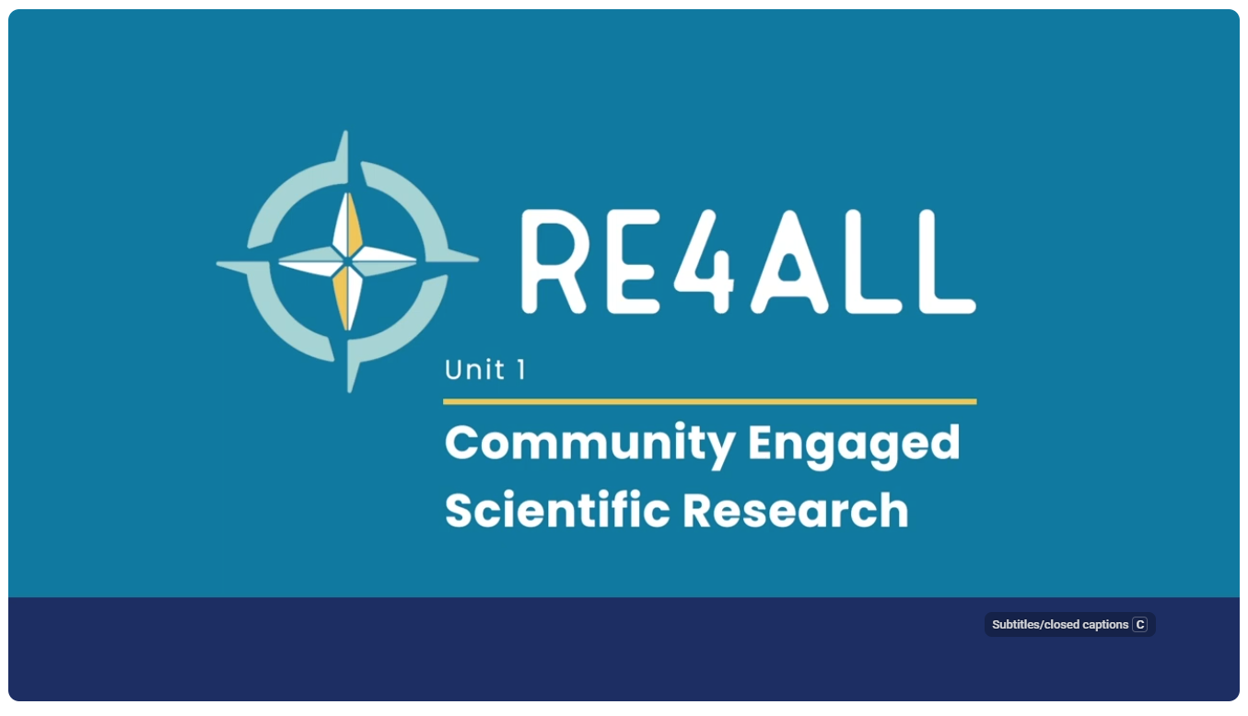

Training Topics
Community-Engaged Scientific Research
History of Scientific Research with People and Rules
Getting People Involved in Research
Keeping Research Participants Safe
Trying out New Treatments, Medicines, and Programs
Community Research Partner Rights
Notes:
Research Ethics for All supports community research partners to learn about ethical practices and decision-making in patient-centered research, including responsible conduct of research. Individuals who complete the training can earn certification in research ethics and research-related compliance for topics relevant to community research partners engaged in patient-centered research.
Research Ethics for All supports community research partners to achieve the following learning outcomes:
Define research with people, jobs of different people on a research team, and ways community research partners can make research better.
Describe rules related to research with people (Belmont principles, The Common Rule, HIPAA, FERPA, FDA, GINA)
State why there are rules for research with people and rights of research participants.
Describe how to use IRB-approved recruitment and consent materials, follow eligibility criteria, and work with children and adults with and without guardians to make informed, voluntary, and ongoing decisions about being in a research study.
Discuss how to keep research participants safe, including in clinical trials, and what to do when there is information that cannot stay confidential.
Explain responsibilities of community research partners, including ways to protect the rights and well-being of people who are in research and community researchers, one’s own team's rules, conflicts of interest, and authorship.

Slide 9
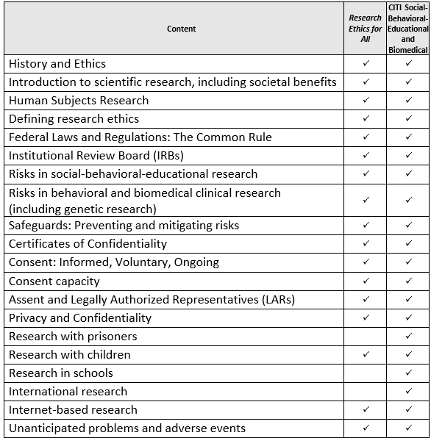
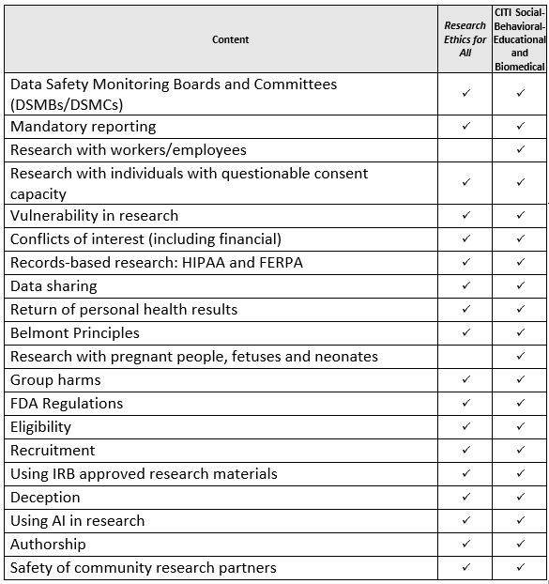
Training Comparison
Notes:
Research Ethics for All provides general research ethics education tailored to the roles and learning needs of community research partners with developmental disabilities. Research Ethics for All is not a substitute for research protocol-specific training, though Research Ethics for All does include add-on activities that may be used with planned protocol-specific training.

Slide 10
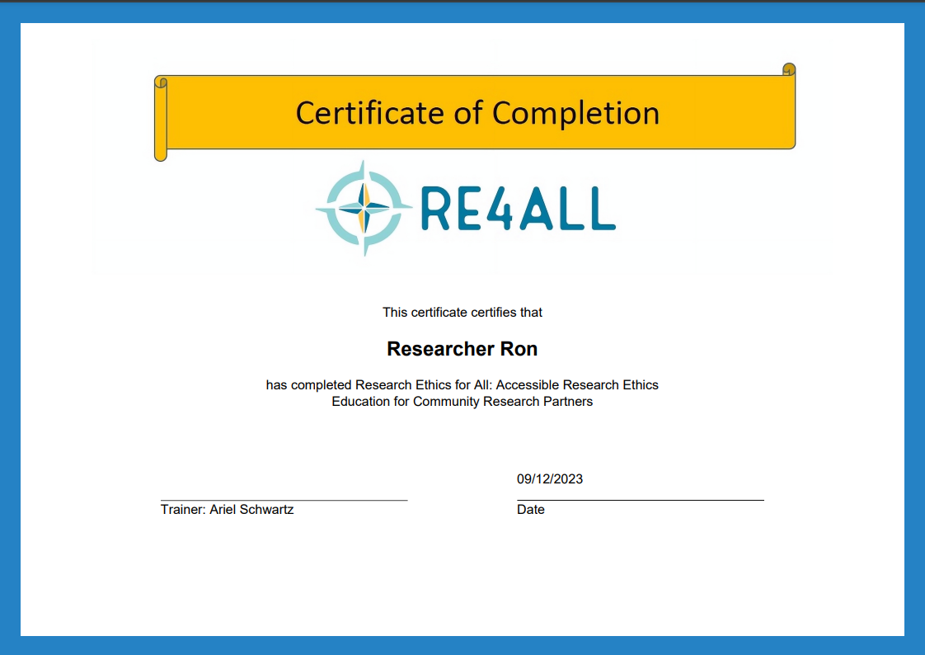
Training Materials and Certification
Didactic Training
Main Ideas
Discussion Questions
Putting in into Action
Research Words
Community Research Partner Rights and Responsibilities
Notes:
After completing the training, the training facilitator works with individual learners to check their understanding of core Learning Outcome concepts. When the person who led the training is satisfied that the learner has obtained a basic level of understanding, they can use the certificate template to issue a certificate to the learner. Project leaders can submit individualized certificates in their IRB application.

Slide 11












IRB Approval
Research Ethics for All can be approved for a single IRB protocol or an available research ethics education program for community research partners at your university

Slide 12
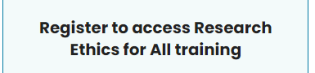


Access Research Ethics for All
www.re4all.org
re4all@syr.edu
Katie McDonald: kemcdona@syr.edu
Ariel Schwartz: ariel.schwartz@unh.edu
Research Ethics for All is also available via CITI with the Human Subjects Research package

